Slide 1
AT-PIC
Automated Testing of Photonic Integrated Chips
Ali Algedheebi - Ben Morrison - Gavin Looney

Slide 2
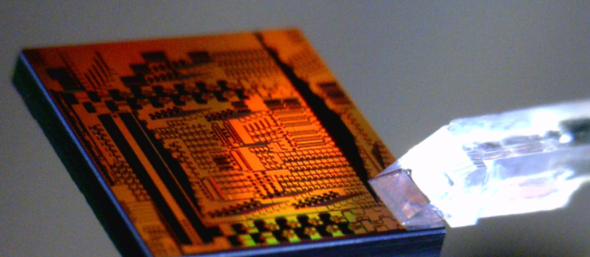
Integrated Silicon Photonic Chips
Higher BW
Energy Efficient
Inherently Faster
Photo was taken from plconnections.com

Slide 3
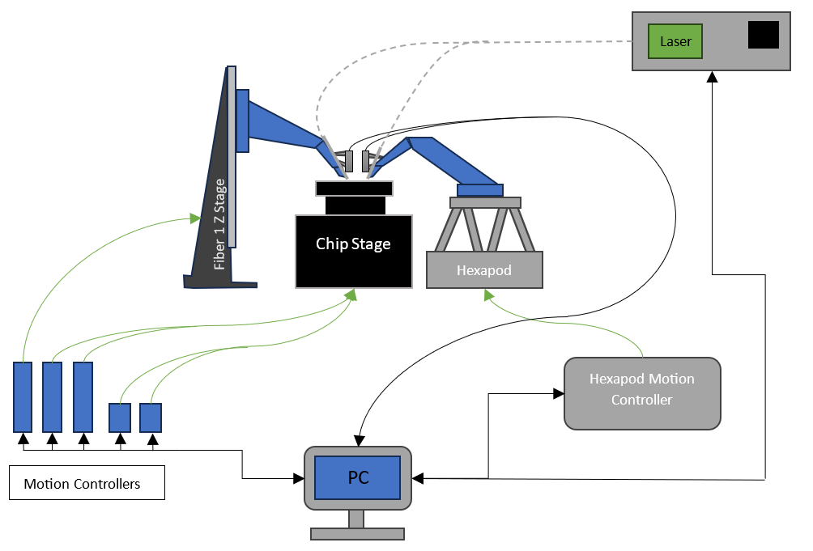
Project Overview

Slide 4
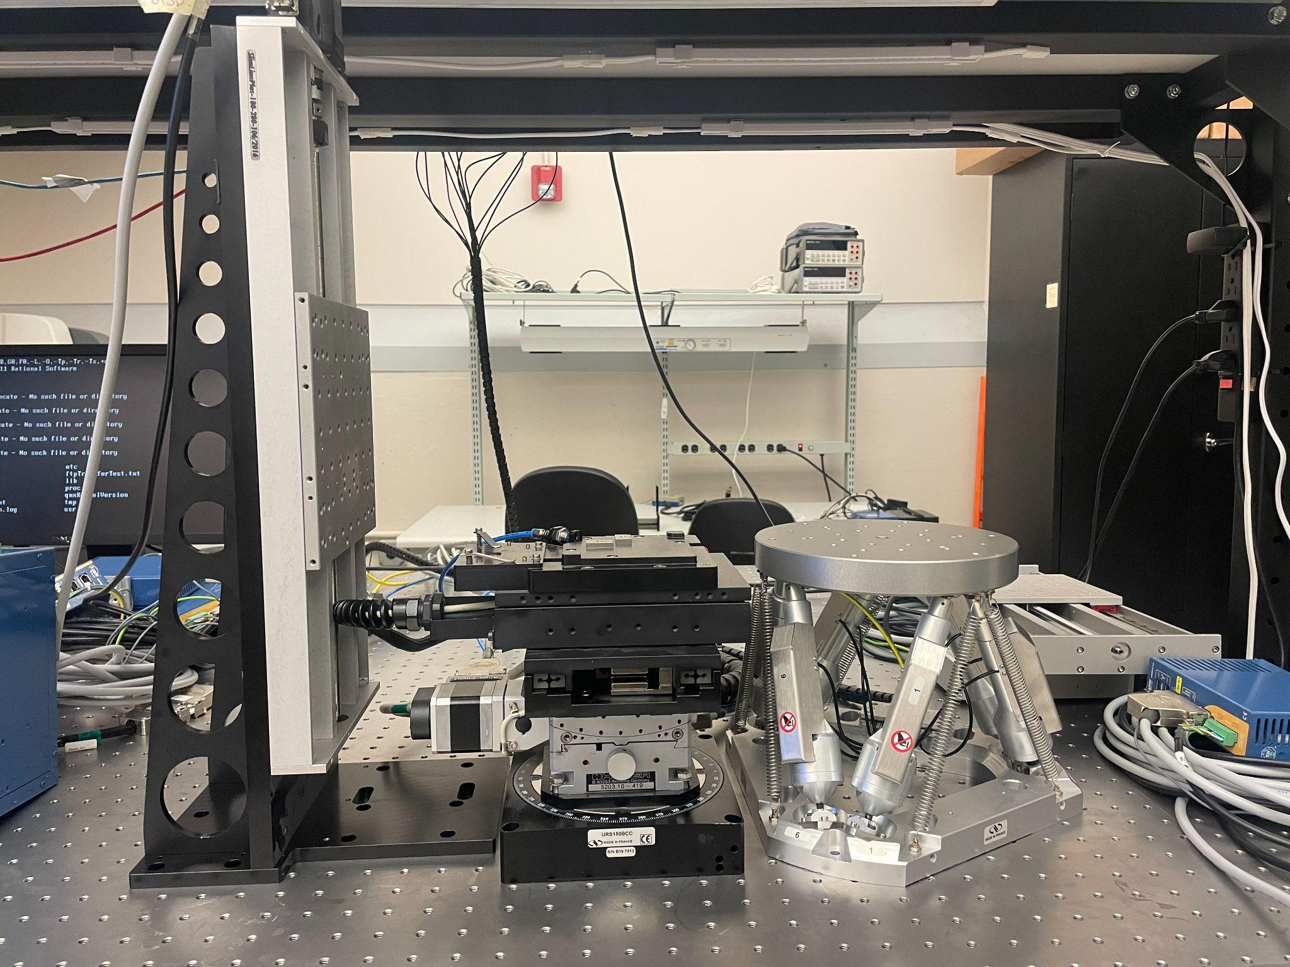
Project Specifications & Requirements
Positional control up to ± 2.5um/0.1° precision
Achieve less than -15dB of loss
90° of directional movement
12mm holes for mounting
Single optical fibers

Slide 5
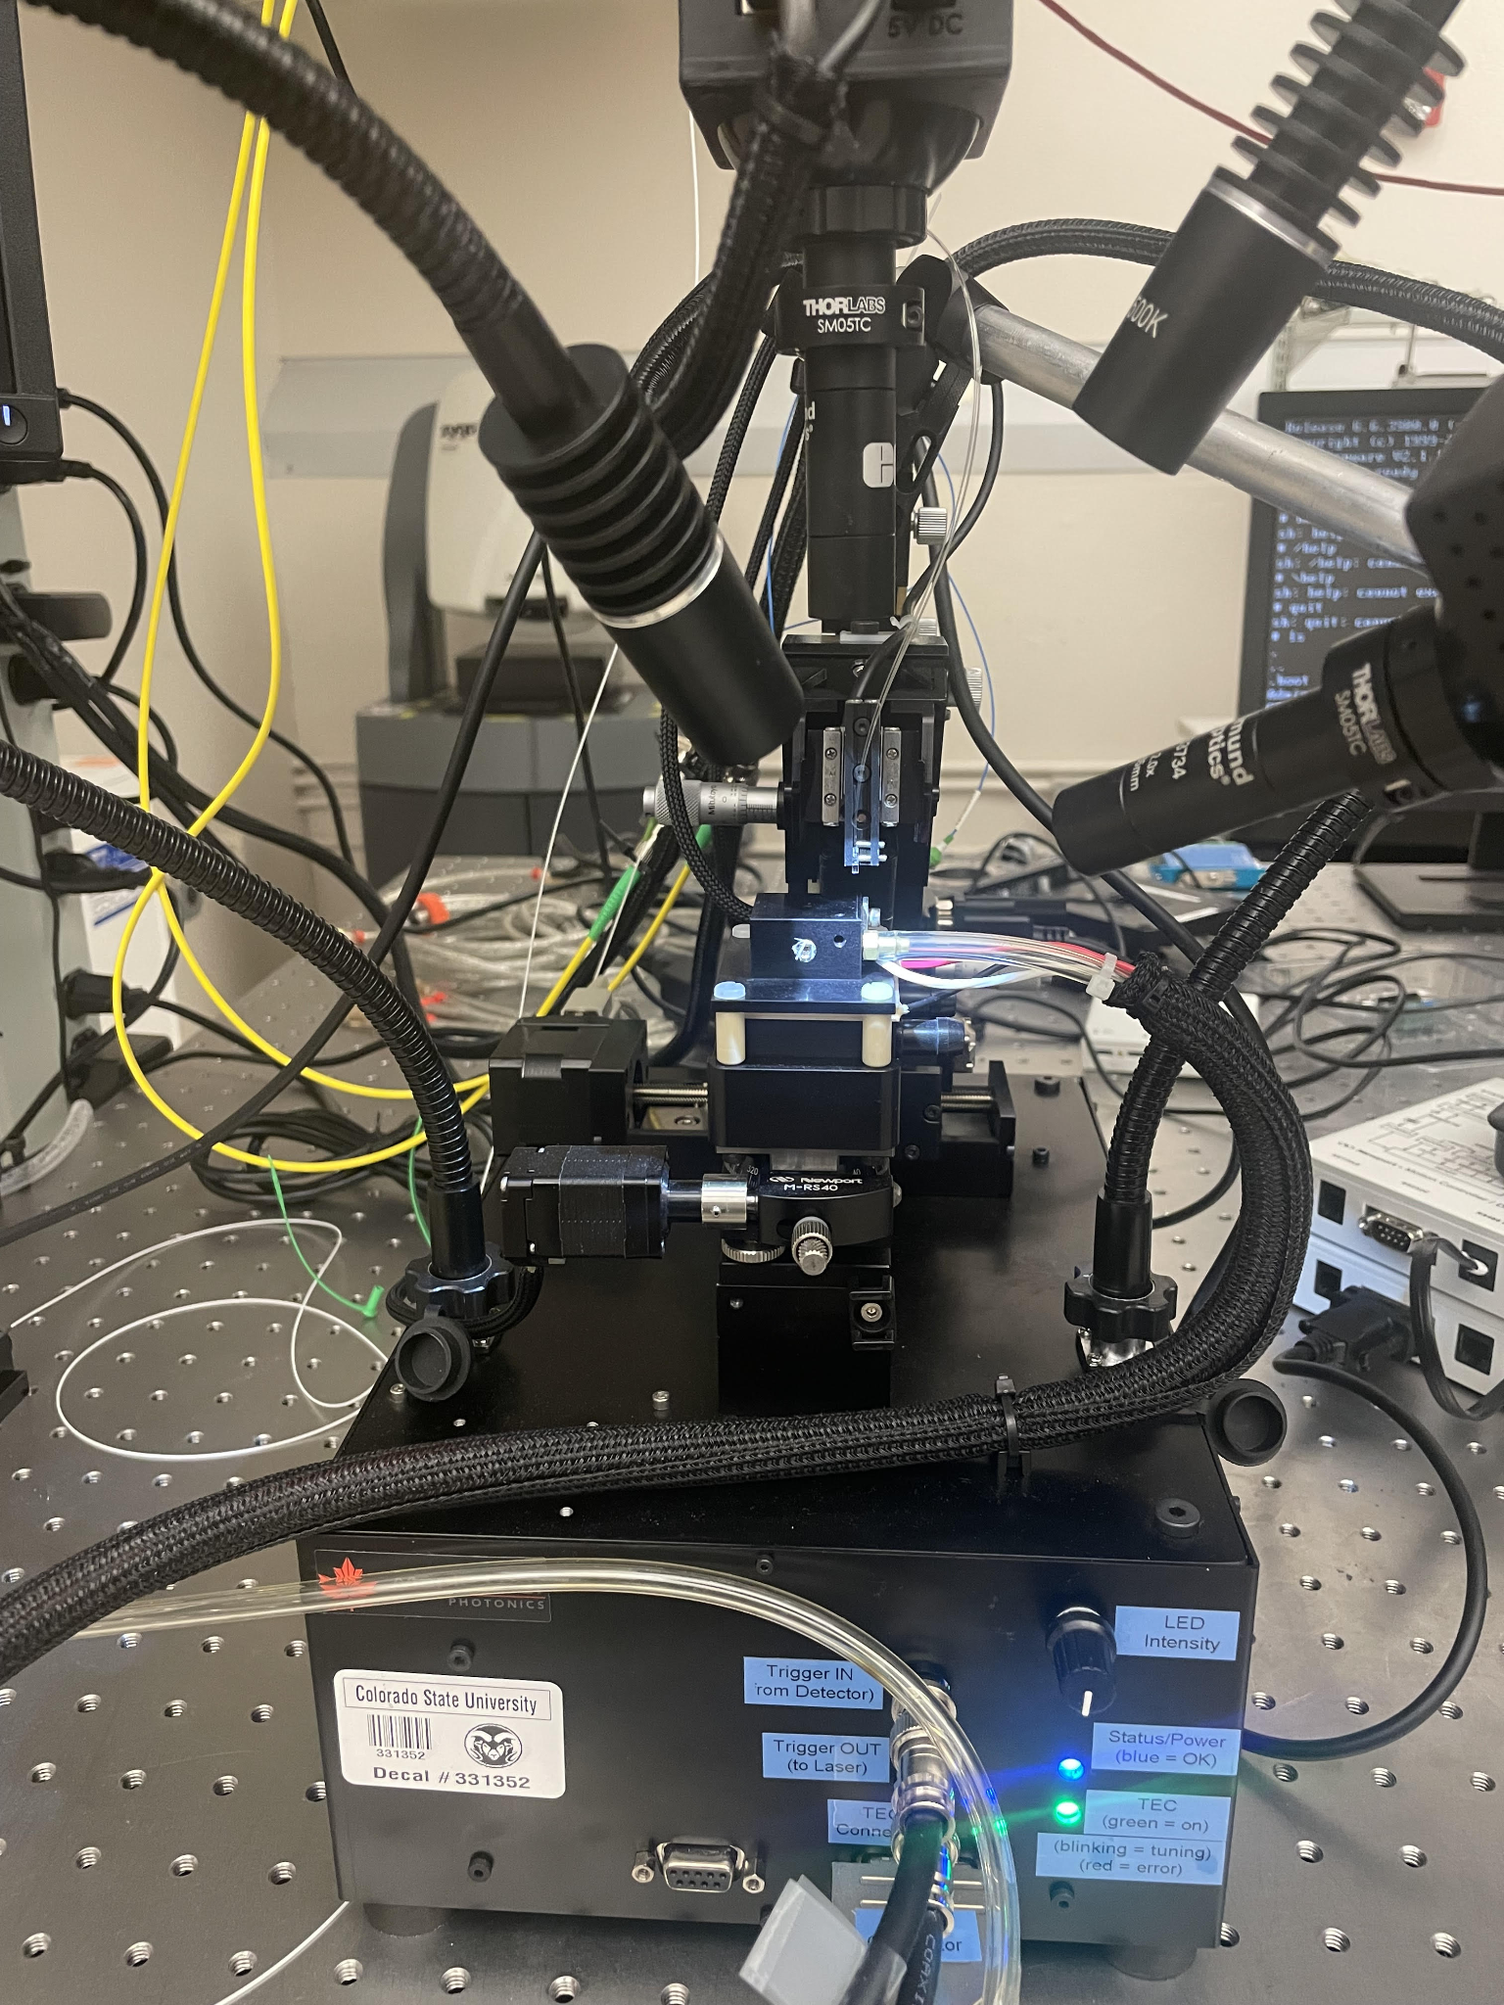
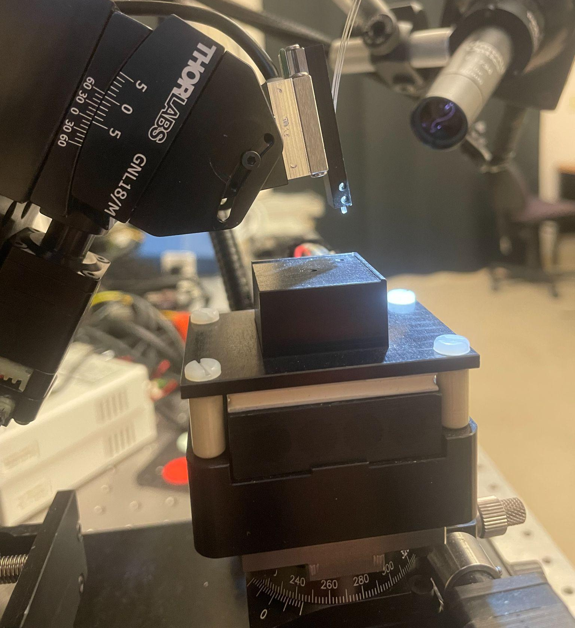
Current Work
Fiber Alignment
Chip Bed
Optical Fiber Array
Low Camera resolution
High power loss
Photo was taken from ECSyD Lab

Slide 6
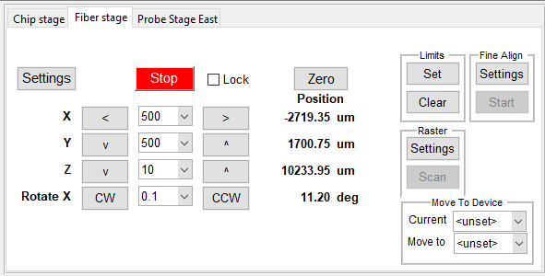
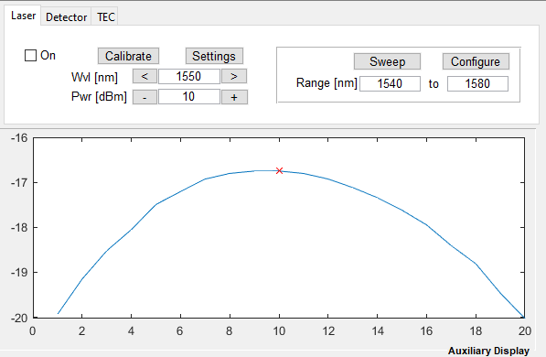
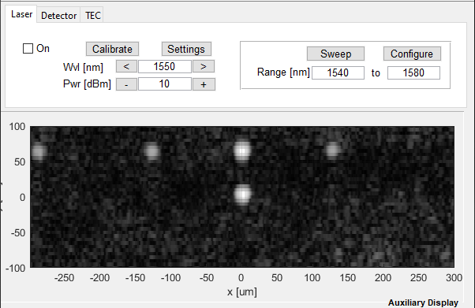
Results From Current WorkStation

Slide 7
Budget
Estimated date when needed | Explain what component; include link, if needed | Price per unit | Quantity | s/h | Total | Lead time (may help planning)
11/6 | 12 x 12mm screws for optics table. | $10.10 | 1 |  | $10.10 | 2 days
10/6 | Crossover ethernet cables | $10.00 | 1 |  | $10.00 | 7 days
11/12 | USB-FlyWire | $3.00 | 8 |  | $24.00 | 14 days
11/12 | RS232-USB | $2.00 | 6 |  | $12.00 | 12 days
11/12 | USB-Wifi Adapter | $4.00 | 1 |  | $4.00 | 14 days
01/20 | M6 Screws | $10.00 | 1 |  | $10.00 | 14 days
11/6 | PS2-USB | $5.00 | 1 |  | $5.00 | 14 days
01/14 | Labview (Tentatively) | $2,200.00 | 1
01/14 | Aerotech Software (Tentatively) | $4,000.00 | 1
01/21 | New Motor Controllers (Tentatively) | $1,000.00 | 6
 |  |  |  | TOTAL | $75.10

Slide 8
Next Semester
Aerotech Software
Implementing Mechanical
Labview Training
Begin UI

Slide 9
Thank You

